Slide 1

Seminar topic: DP1 - APACHE STORM Real-time Distributed Stream Processing
Course: Introduction to Big Data
Class: 21KHMT2
Group ID: KHMT2-11
Ho Chi Minh City, 2024

Slide 2




GROUP KHMT2-11 INFORMATION
LÊ SỬ TRIỀU AN
VÕ
DUY ANH
TRẦN
HIẾU TÂM
NGUYỄN LÊ
HOÀNG KHA
Student ID: 21127210
Email: lstan21@clc.fitus.edu.vn
Student ID: 21127221
Email: vdanh21@clc.fitus.edu.vn
Student ID: 21127423
Email: thtam21@clc.fitus.edu.vn
Student ID: 21127512
Email: nlhkha21@clc.fitus.edu.vn

Slide 3
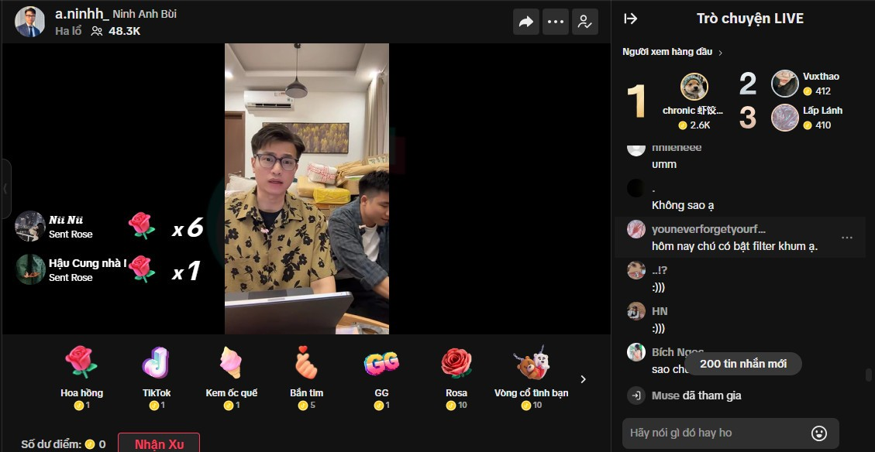


What are the common points in these examples?

Slide 4


How many posts and tweets are shared on FB and X daily?
4.75 billion items daily
~ 54,977 items/s
500 million items daily
~ 5,787 items/s

Slide 5


What happened on the evening of March 5th, 2024?

Slide 6


01. Introduction to Apache Storm
02. The Insights of Apache Storm
03. Applications and Popularity
Contents
What is Apache Storm?
Brief History and Design Goals
Major Components
Cluster Architecture
Storm Example
Academic/industry use cases
Popularity
04. Demonstration
Description
Implementation
05. Discussions and Conclusion
Comparison
Pros and Cons
Summary

Slide 7

01.
Introduction to Apache Storm
“Without big data, you are blind and deaf and in the middle of a freeway.”
– Geoffrey Moore

Slide 8

01. Introducion | What is Apache Storm?
Storm is a real-time fault-tolerant and distributed stream data processing system.
Fault-tolerant
processing
Real-time
Distributed
Stream data

Slide 9




01. Introducion | Which problems could be solved by using Apache Storm?
Real-time Data Processing
Apache Storm's event-driven architecture facilitates real-time data processing, leveraging event triggers for continuous and efficient analysis of data streams, ideal for applications such as fraud detection and real-time analytics.
Distributed Computing
Apache Storm excels in distributed computing by parallelizing tasks across processors, machines, or clusters, ensuring optimal performance and scalability for large-scale data sets.
Fault tolerance
Apache Storm revolutionized fault tolerance in Big Data, surpassing previous solutions like Hadoop MapReduce, HDFS, and Spark, and enhancing system consistency and stream processing capabilities.
Interactive Applications
Apache Storm's real-time processing excels in interactive applications, ensuring swift responses in virtual assistants, gaming platforms, and video conferencing tools.

Slide 10
01. Introducion | Design Goals
Scalable
Resilient
Extensible
Efficient
Easy to Administer
Adding or removing nodes from the Storm cluster should be easy.
The Storm cluster must continue processing current work with a minimal performance impact.
Storm needs an extensible framework as It can add calls to arbitrary external functions.
It must have good performance characteristics for real-time applications.
Easy-to-use administration tools are a critical requirement for operations.

Slide 11
—SOMEONE FAMOUS
“Storm is one of early open-source and popular stream processing systems.”

Slide 12
—SOMEONE FAMOUS
“The Hadoop of real time.”

Slide 13

02.
The Insights of Apache Storm
“Without big data, you are blind and deaf and in the middle of a freeway.”
– Geoffrey Moore

Slide 14


02. The Insights | Idea
Traditional interview process

Slide 15
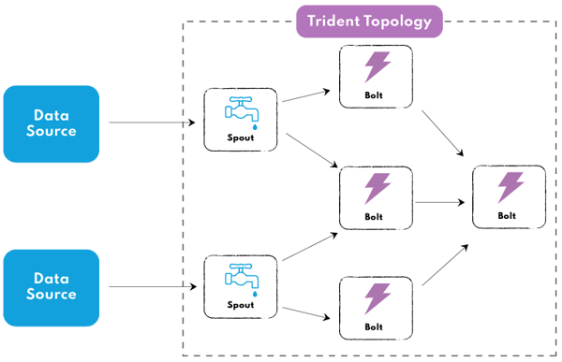
02. The Insights | Idea

Slide 16
02. The Insights | Major Components
Tuple: Ordered list of elements, basic data structure.
Stream: Unordered, unbounded sequence of tuples.
Spout: Ingests data, creates streams for bolts.
Bolt: Processes streams, performs operations (filter, aggregate, etc.), outputs new streams.
Topology: directed graph with vertices are processing units (spouts & bolts), edges are data streams, defines real-time application logic

Slide 17
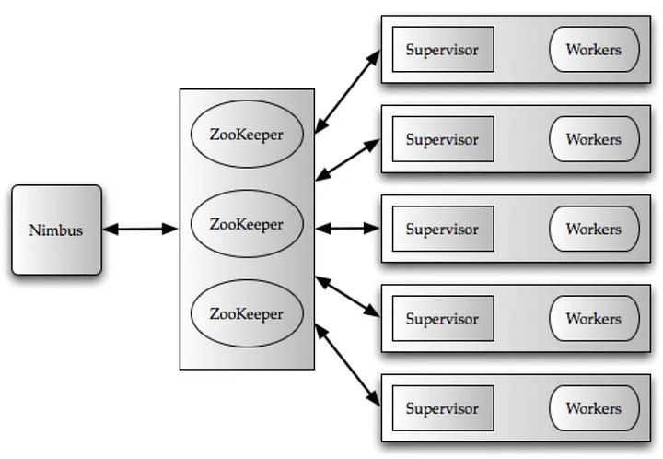
02. The Insights | Cluster Architecture

Slide 18
02. The Insights | Flow of Works

Slide 19
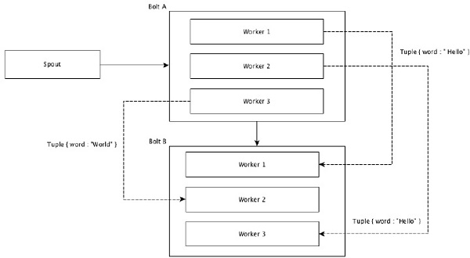
02. The Insights | Stream Grouping
Shuffle Grouping

Slide 20
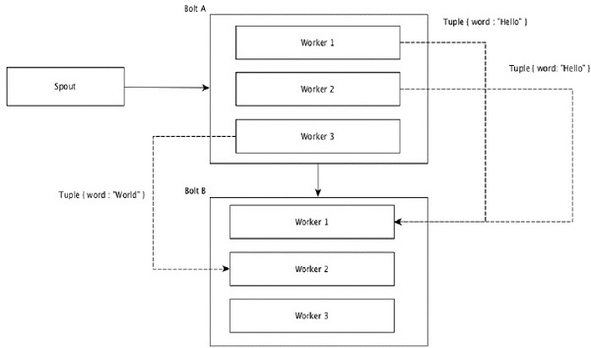
02. The Insights | Stream Grouping
Field Grouping

Slide 21
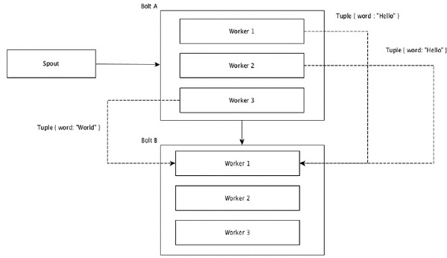
02. The Insights | Stream Grouping
Global Grouping

Slide 22
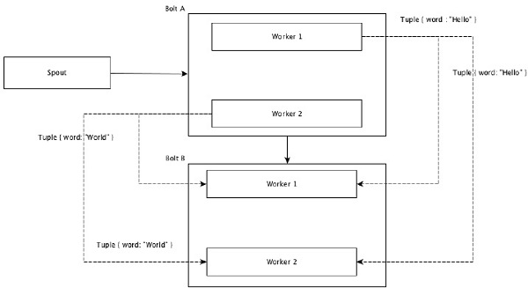
02. The Insights | Stream Grouping
All Grouping

Slide 23
02. The Insights | Storm Example
Problem
Today's platforms like Facebook and X see billions of daily shares, but also expose users to harmful content, necessitating a swift bad keyword detection system.
The system needs to classify whether the shared item is VALID to post or should be BANNED?

Slide 24
02. The Insights | Storm Example
Solution
This system comprises one spout and two bolts. The spout retrieves data from the external system and converts it into tuples. These tuples undergo processing by two bolts: Bolt1 handles tuples with a VALID status, saving them to a database, while Bolt2 manages tuples with a BANNED status, logging them into an error file.

Slide 25
02. The Insights | Storm Example
Storm topology
Status = VALID
Bolt 1
Database
Data source
Spout
Status = BANNED
Bolt 1
Error Log

Slide 26

03.
Applications and Popularity
“Without big data, you are blind and deaf and in the middle of a freeway.”
– Geoffrey Moore

Slide 27
Speed: 1,000,000*
tuples processed /second / node
*Source from https://storm.apache.org/

Slide 28



03. | Applications
Real Time Analytics
Machine Learning
Unbounded Stream Processing
Computation System

Slide 29
03. | Applications
Financial Services:
Telecom & Media
E-commerce
Web
• Securities Fraud
• Compliance Violations
• Order Routing
• Pricing
• Security Breaches
• Network Outages
• Bandwidth Allocation
• Customer Service
• Shrinkage
• Stock outs
• Offers
• Pricing
• Application Failure
• Operational Issues
• Personalized Content
Notes:
Real-Time Analytics
Data processing in the field of data science
Financial Services: Storm supports risk assessment and management by continuously monitoring financial data for potential risks or irregularities.
E-commerce: Real-time data processing related to transactions and statistics.
Information and entertainment media: Providing experiential videos and real-time search data to users on online platforms.

Slide 30

80*
major global companies have used Apache Storm
*Source: https://storm.apache.org/Powered-By.html

Slide 31







03. | Popularity
List of companies using Apache Storm.
Source: https://storm.apache.org/Powered-By.html

Slide 32
03. | Popularity
*Source: https://storm.apache.org/Powered-By.html

Slide 33
03. | Popularity
*Source: https://storm.apache.org/Powered-By.html
Notes:
There are many companies in the world that use Apache Storm in their systems. On Apache Storm's website, they list over 80 major companies have used:
Spotify: Storm powers many real-time features at Spotify, including music recommendations, monitoring, analytics, and ad targeting.
Twitter, Taobao, The Weather Channel, Yahoo!, Alibaba, Klout,…

Slide 34
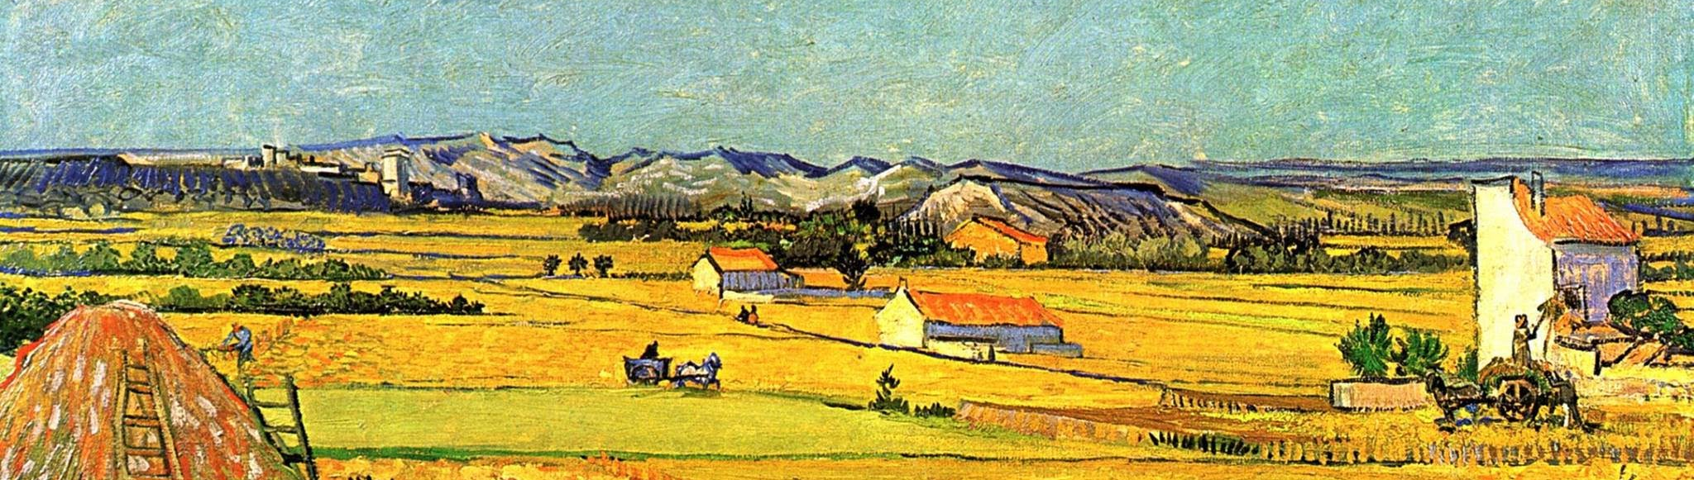
04.
Demonstration
“Without big data, you are blind and deaf and in the middle of a freeway.”
– Geoffrey Moore

Slide 35
04. Demonstration

Slide 36
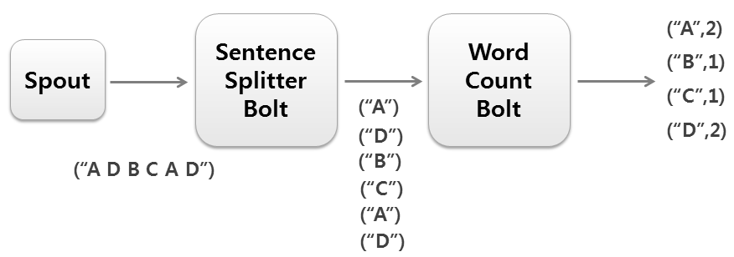
04. Demonstration | WordCount Problem
Figure: How to count word by using Apache Storm with Spout and Bolt

Slide 37
04. Demonstration | Storm Running Modes
Local Mode
Remote Mode

Slide 38




04. Demonstration | Storm Running Modes
Local Mode
Development
Debugging
Testing

Slide 39

04. Demonstration | Storm Running Modes
Topology is submitted to the Storm cluster, spanning multiple machines.
Remote Mode
Provides true distributed processing capabilities of Storm.
Scales to handle large data volumes and complex processing needs.

Slide 40

05.
Discussions and Conclusion
“Without big data, you are blind and deaf and in the middle of a freeway.”
– Geoffrey Moore

Slide 41


05. | Apache Storm vs. Apache Hadoop
Real-time streaming data processing | Type of data processing | Batch processing
Integration with Apache Mahout | Machine learning support | Can be combined with other tools for ML
Fault-tolerant architecture | Availability | Suitable for distributing and processing
Designed for high-performance real-time processing | Performance | MapReduce for processing vast data
Wide range of developer tools and integration | Developer tools & integration | Integrates with various frameworks

Slide 42

05. | Apache Storm vs. Apache Flink
Real-time streaming data processing | Type of data processing | Batch and stream processing tasks
Integration with Apache Mahout | Machine learning support | Machine learning libraries such as FlinkML
Fault-tolerant architecture | Availability | Checkpointing and savepointing for fault tolerance
Designed for high-performance real-time processing | Performance | High performance with optimization techniques
Wide range of developer tools and integration | Developer tools & integration | Various developer tools like Flink CLI, Dashboard, etc

Slide 43

05. | Apache Storm vs. Google Cloud Dataflow
Real-time streaming data processing | Type of data processing | Batch and stream processing tasks
Integration with Apache Mahout | Machine learning support | Built-in support for machine learning tasks
Fault-tolerant architecture | Availability | Built-in fault tolerance and auto-scaling
Designed for high-performance real-time processing | Performance | High-performance data processing with near-real-time
Wide range of developer tools and integration | Developer tools & integration | Dataflow SDKs, Apache Beam, and SQL

Slide 44
05. | Pros
1. Fault tolerance
2. Scalability
3. Flexibility
It provides fault tolerance and guarantees data processing, even in the event of node failures.
Apache Storm is horizontally scalable, allowing you to add more nodes to handle increasing workloads.
It supports multiple programming languages and provides a high degree of flexibility in designing data processing topologies.

Slide 45
05. | Cons
1. Complexity
2. Learning curve
3. Operational overhead
Setting up and managing Apache Storm clusters can be complex, requiring expertise in distributed systems and infrastructure management.
Developers may need time to learn the concepts and APIs of Apache Storm, especially if they are new to real-time data processing.
Managing and monitoring a distributed system like Apache Storm requires additional operational overhead compared to simpler batch processing systems.

Slide 46
05. | Summary
Storm processes data streams using its tuple and stream-based model.
It employs spouts to generate tuples, which are then processed by bolts.
Spouts and bolts collectively create the Storm topology.
Storm utilizes a master-slave architecture with Nimbus as the master and supervisors as slaves.
Supervisors monitor workers responsible for data processing.
Apache Storm can be called as “Hadoop of real-time”.
Apache Storm is commonly used in many platforms and fields, on a global scale.

Slide 47
05. | Summary
“Storm is one of early open-source and popular stream processing systems.”
—SOMEONE FAMOUS

Slide 48
References
Le Ngoc Thanh, Nguyen Ngoc Thao. Lecturer Slides. Online resource of FIT@HCMUS. Update: March 23rd, 2024.
Ankit Toshniwal, Siddarth Taneja, Amit Shukla, Karthik Ramasamy, Jignesh M. Patel*, Sanjeev Kulkarni, Jason Jackson, Krishna Gade, Maosong Fu, Jake Donham, Nikunj Bhagat, Sailesh Mittal, Dmitriy Ryaboy. Storm @Twitter. Twitter, Inc. Online resource. Published: June 18th, 2014
Hemant Gupta. Insights from paper — Storm @Twitter. Online resource. Published: August 12th, 2023
Tutorials Point. Apache Storm Tutorial. Online resource. Update: March 23rd, 2024.
Minh Huyen. Giới thiệu về Apache Storm. Online resource. Published: September 17th, 2019
Zachradtka. GitHub - zachradtka/Storm: Examples using Apache Storm.
Apache Storm. (n.d.).

Slide 49

THANK YOU FOR YOUR ATTENTION
Group KHMT2-11: DP1 - Apache Storm
Introduction to Big Data, 21KHMT2
Contact information:
VNUHCM - University of Science
Faculty of Information Technology
Address: 227 Nguyen Van Cu Str., District 5, HCMC

Slide 50


Q&A
Google Form for giving questions and evaluating the team, provided by Lecturers.

